Slide 1
Department of Government Services

Slide 2
ZAP: Anomaly Detection
Dhruv Nirmal and Kumar Vatsal
Semester 2, 2023
Department of Econometrics and Business Statistics, Monash University

Slide 3

Victorian Center for Data Insights
About the company
VCDI exist to transform the way Victorian Government uses data to deliver better policies and services for the benefit of all Victorians.
Victorian Government collects a lot of data - from education and health, to data on business, communities, infrastructure and the environment . This data is only valuable if it helps us make better decisions.
Improving how Victorian Government uses data can benefit every area of policy and service delivery. It can deliver fresh insights into how our health, education and transport systems work. It can reveal what creates safe and livable communities, with jobs and economic opportunities for citizens. It can help us manage our environment and public spaces.

Slide 4
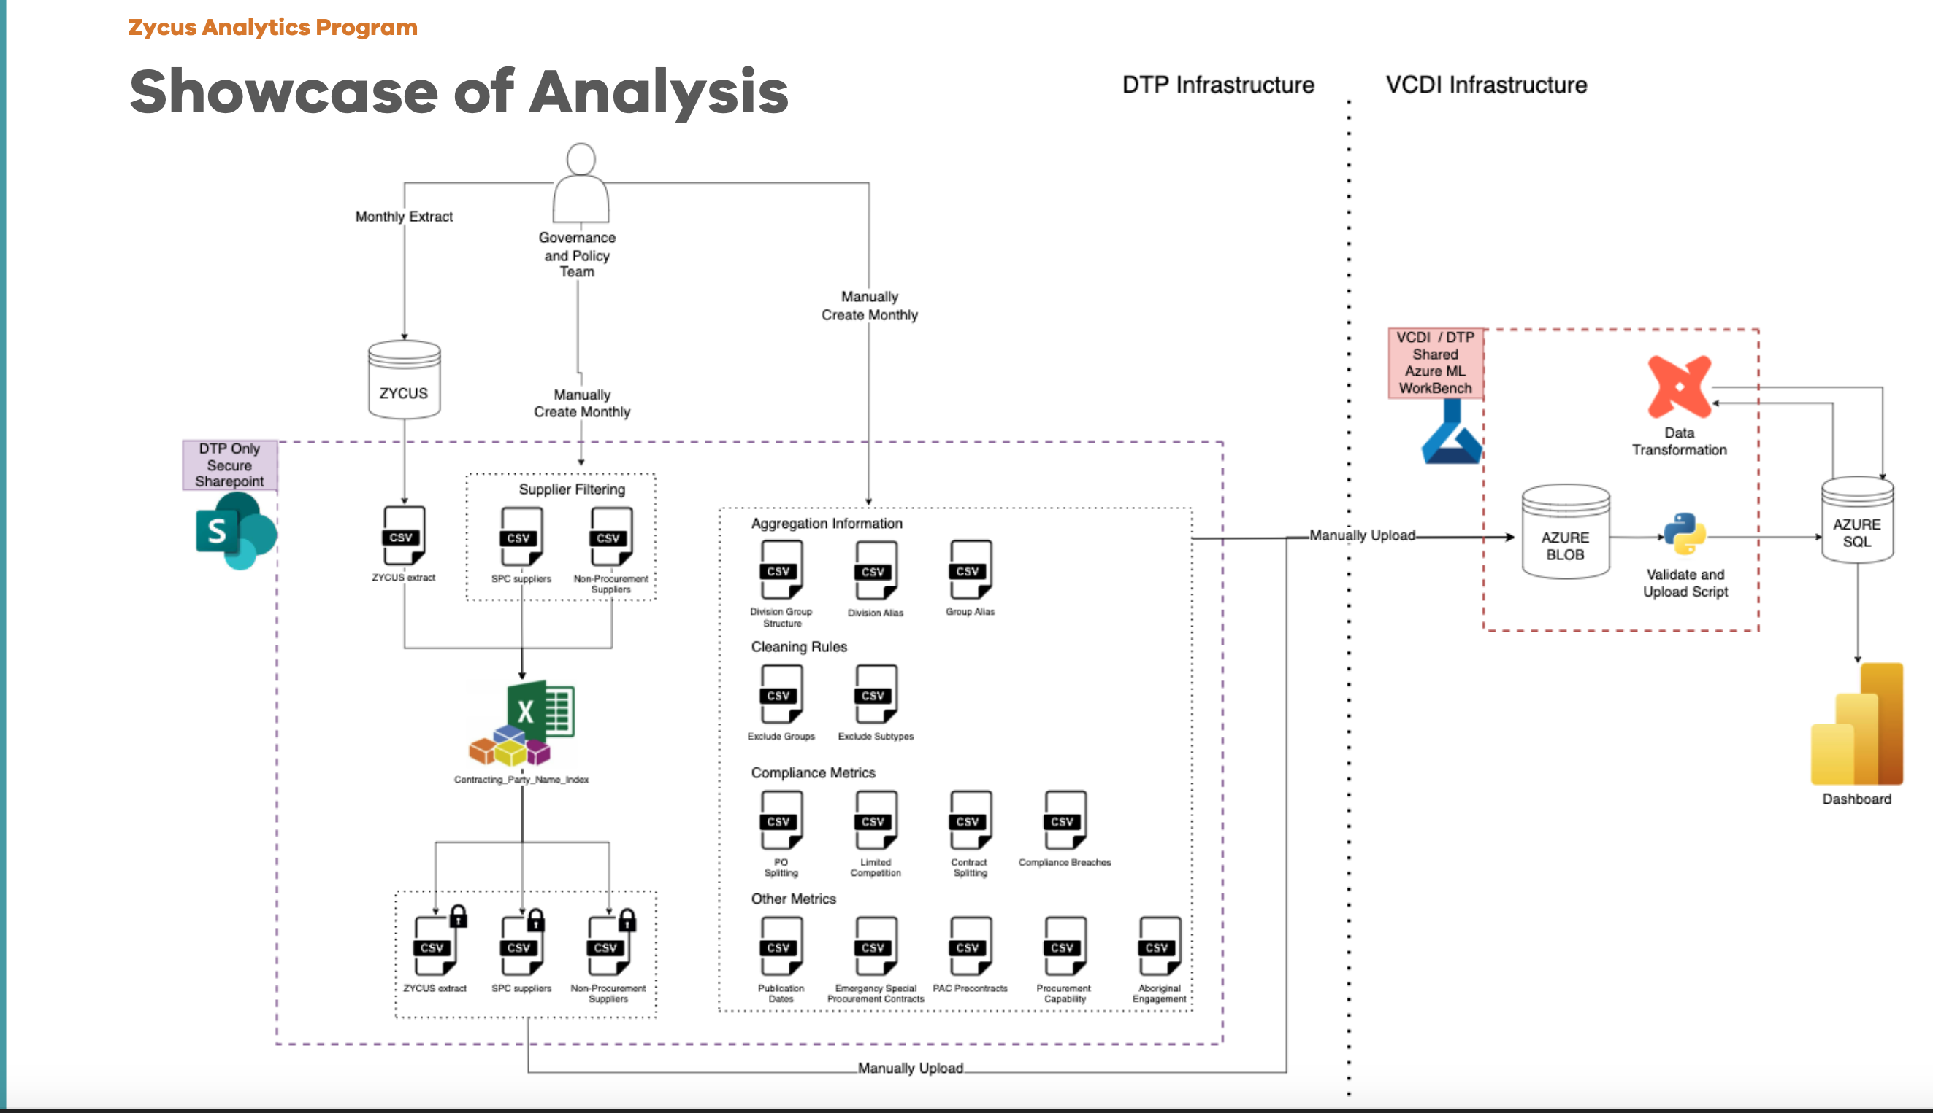
Zycus Analytics Program

Slide 5
Workflow
EDA
Understanding existing code flow
Preliminary Analysis
Modelling
Model Selection
Model Visualisation
Combining Models
Functionalising the code
Top 20 Anomalies

Slide 6
Preliminary Analysis

Slide 7
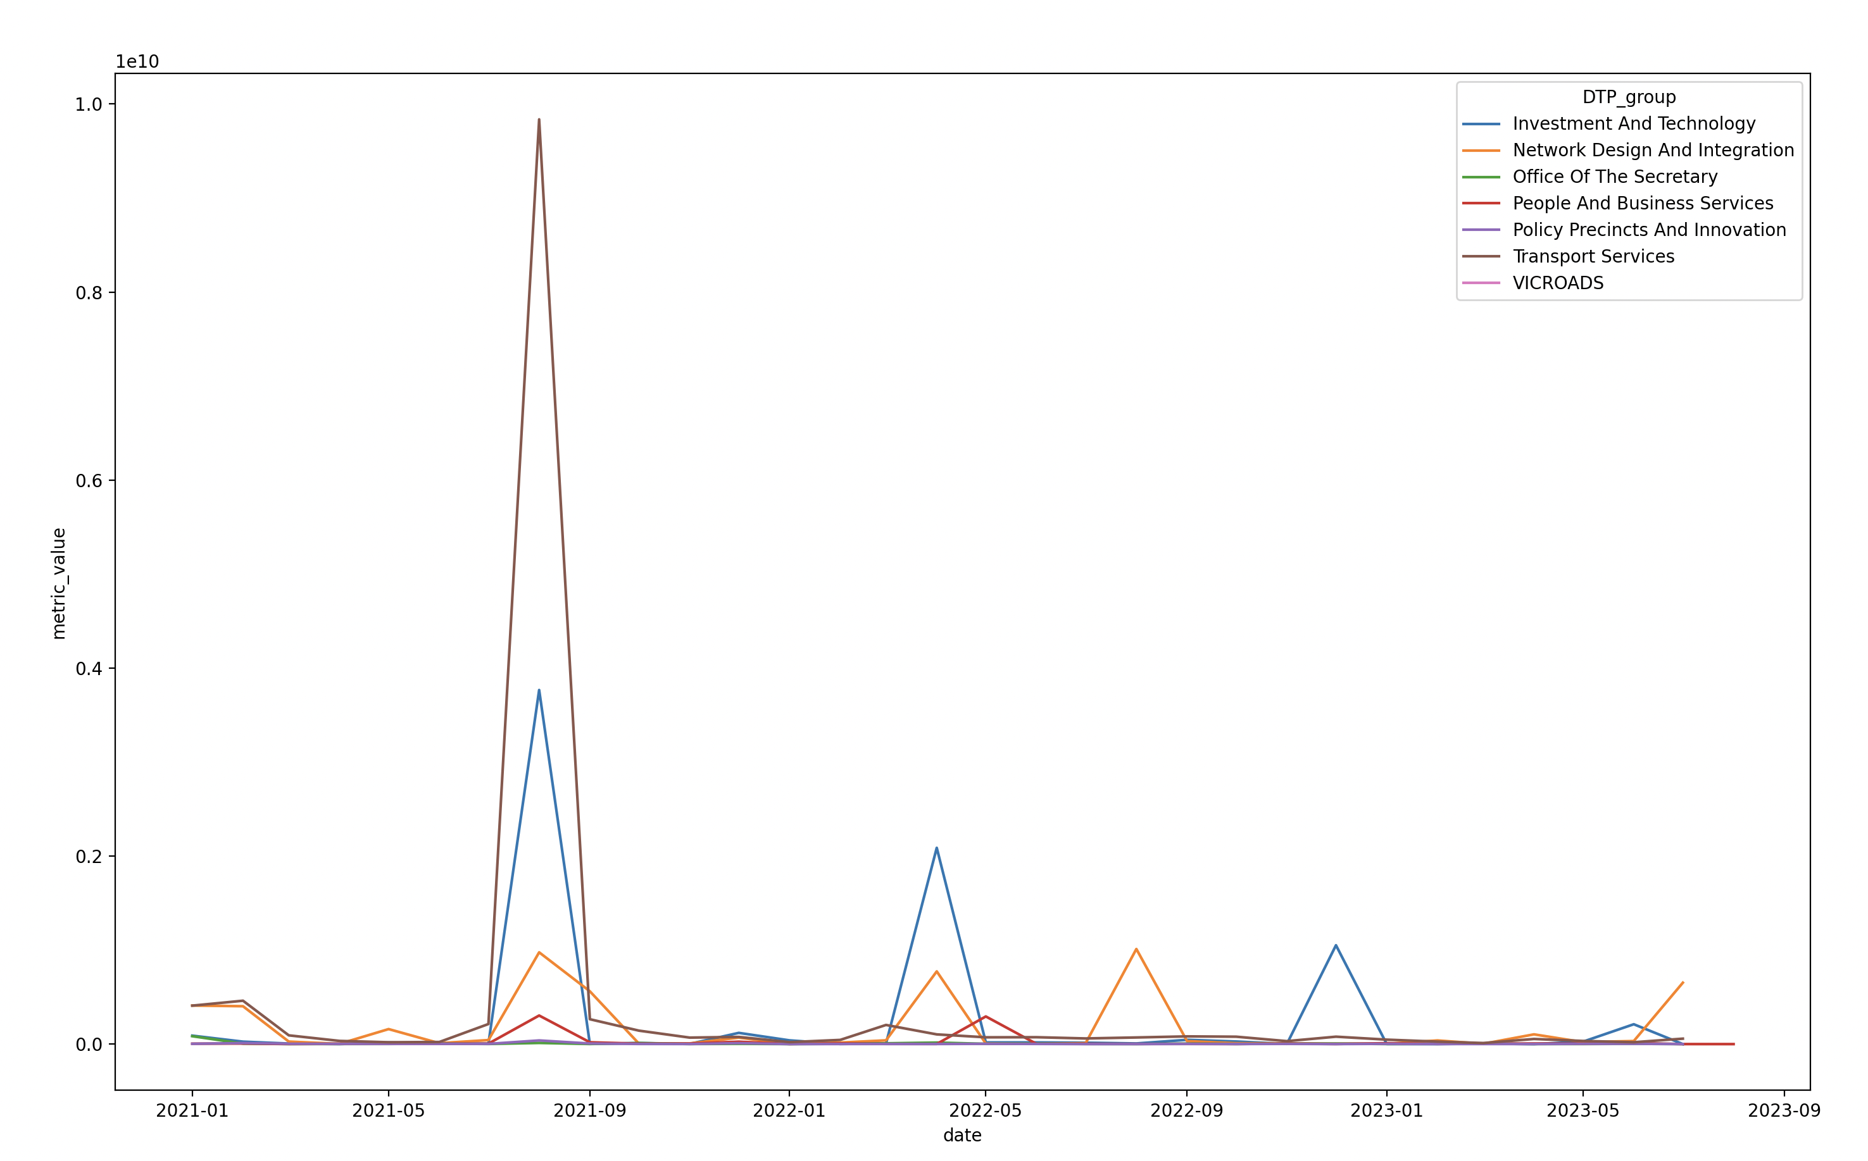
Full Time Series

Slide 8
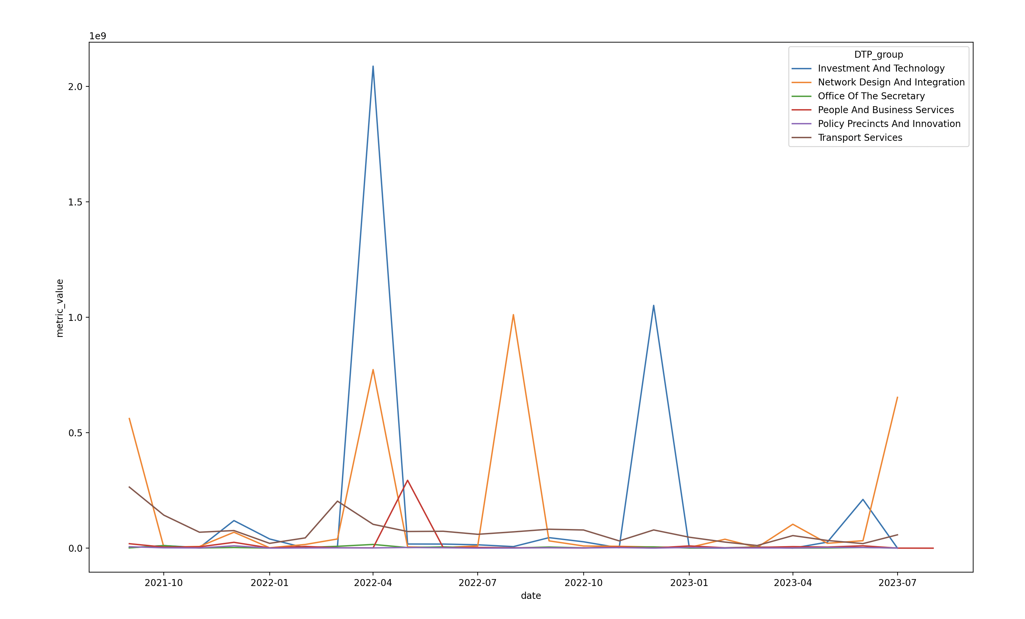
After Aug, 2021 Time Series

Slide 9
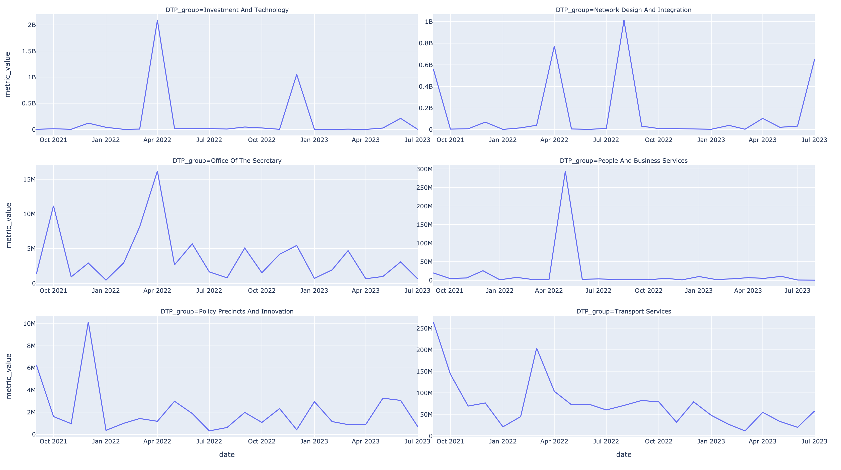
After Aug, 2021 Time Series

Slide 10
Anomaly detection Models

Slide 11
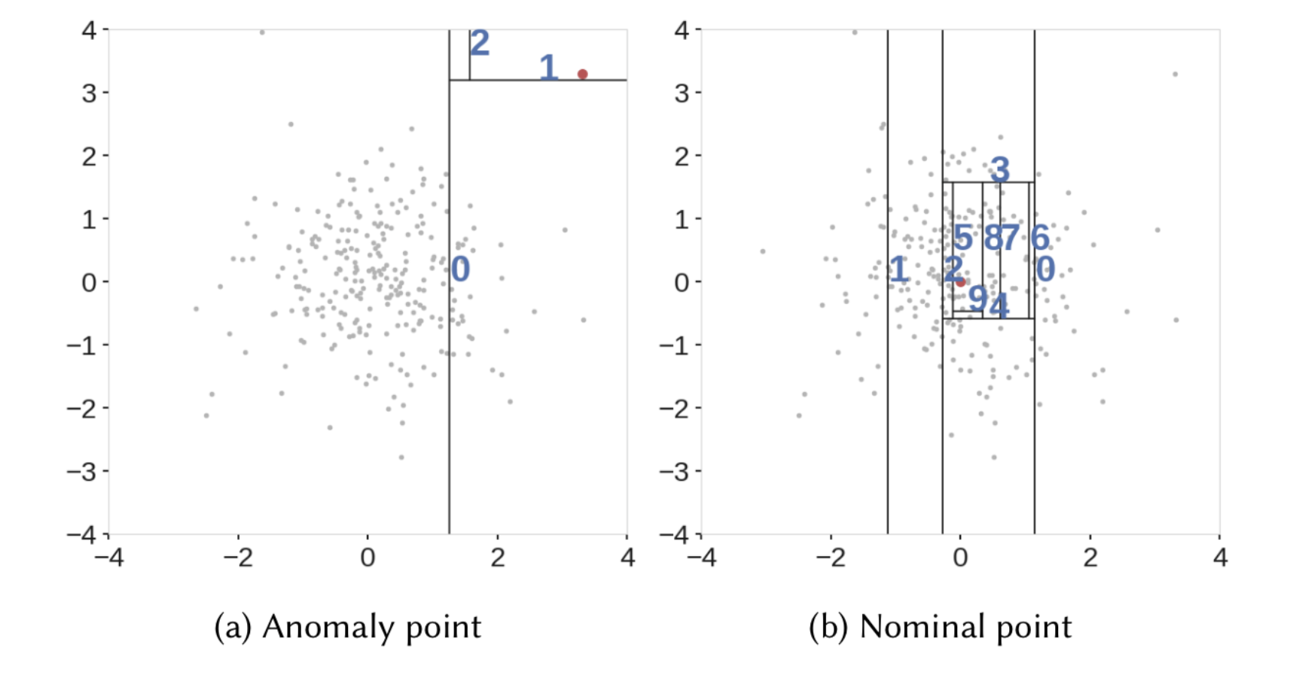
Isolation Forest
Anomaly detection method
The approach employs binary trees to detect anomalies, resulting in a linear time complexity and low memory usage that is well-suited for processing large datasets.
The samples that travel deeper into the tree are less likely to be anomalies as they required more cuts to isolate them. Similarly, the samples which end up in shorter branches indicate anomalies as it was easier for the tree to separate them from other observations.
Contamination factor: It refers to expected proportion of outliers in the data
n_estimator: number of trees built in the forest method

Slide 12
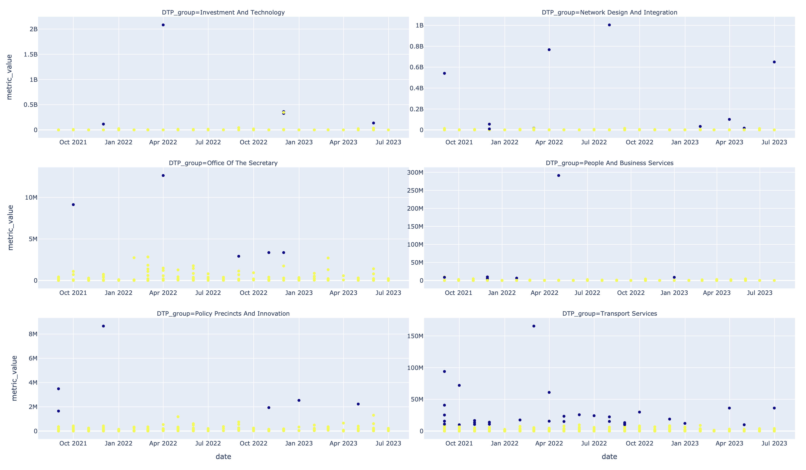

Slide 13
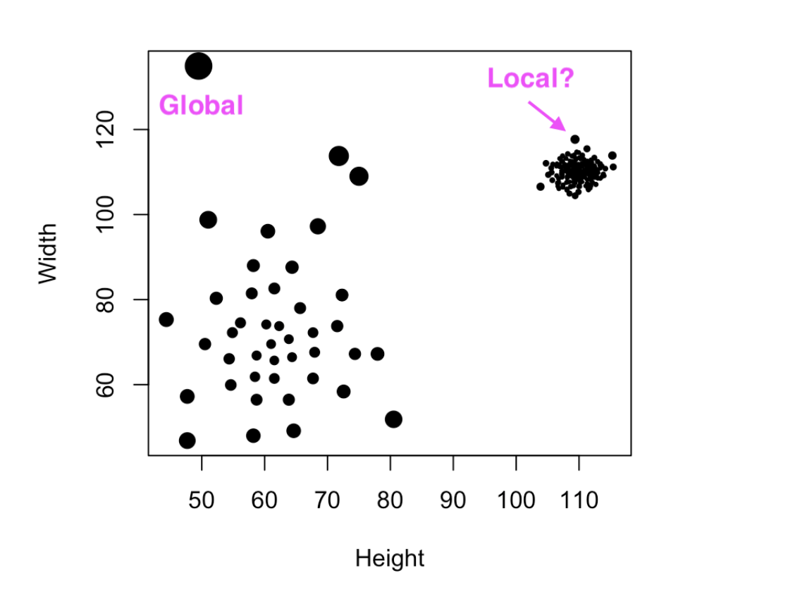
Local Outlier Factor
Anomaly detection method
Local Outlier Factor is another anomaly detection technique that takes the density of data points into consideration to decide whether a point is an anomaly or not.
n_neighbours: No of neighbours the model takes into account while deciding the point is an anomaly or not
contamination: proportion of the data we expect to be anomalous

Slide 14
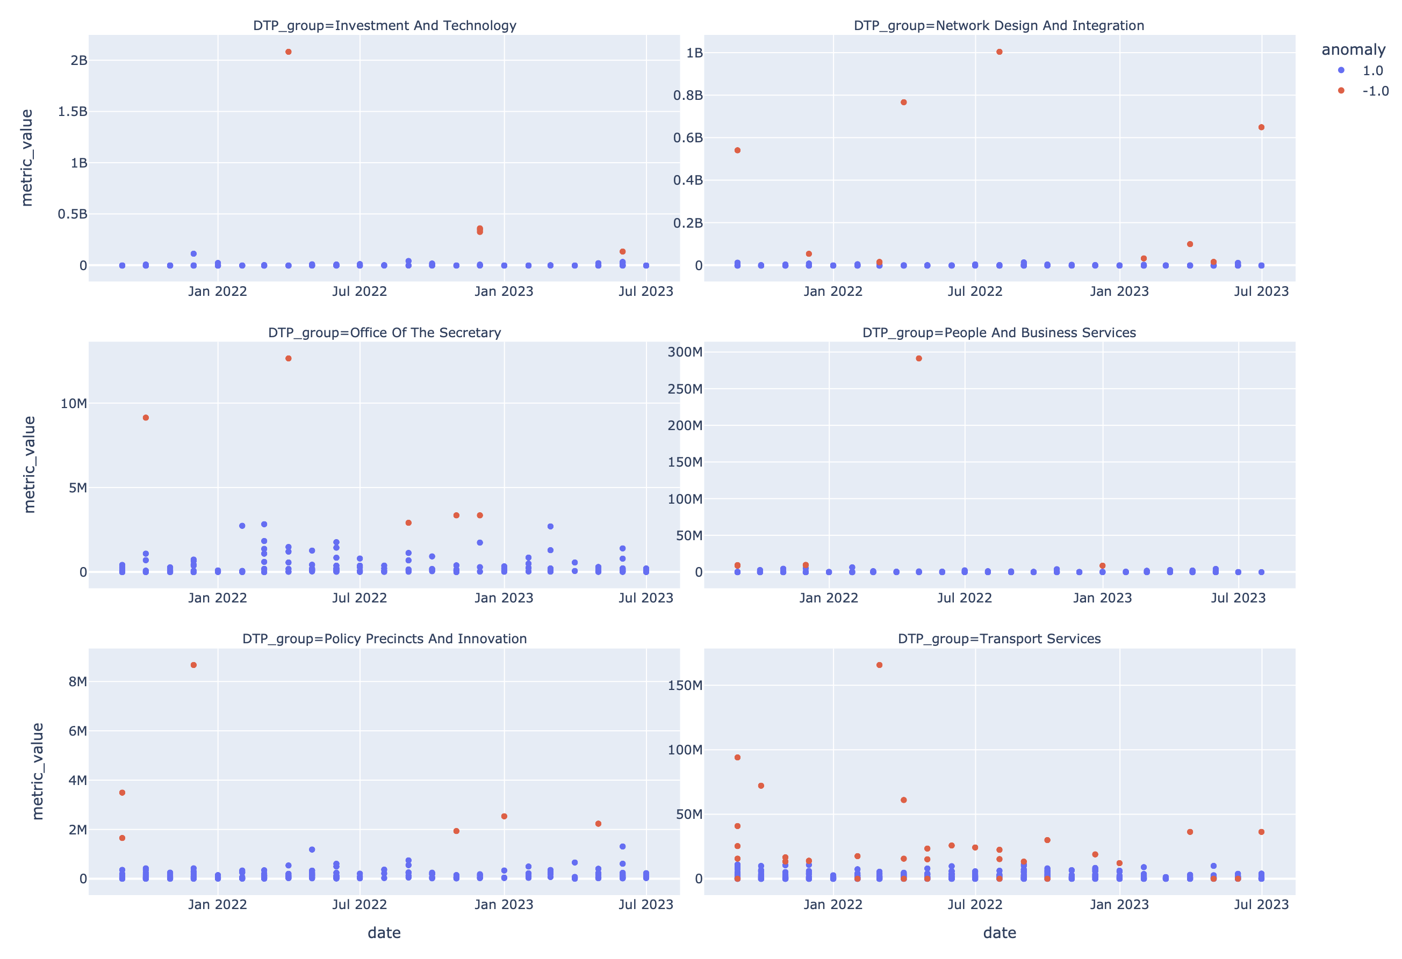

Slide 15
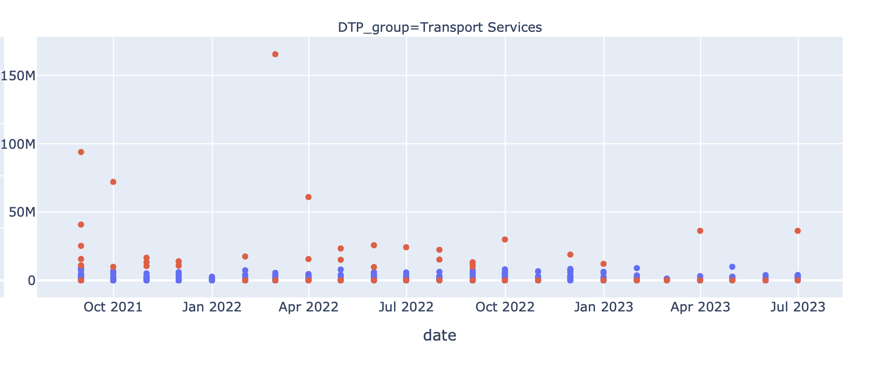
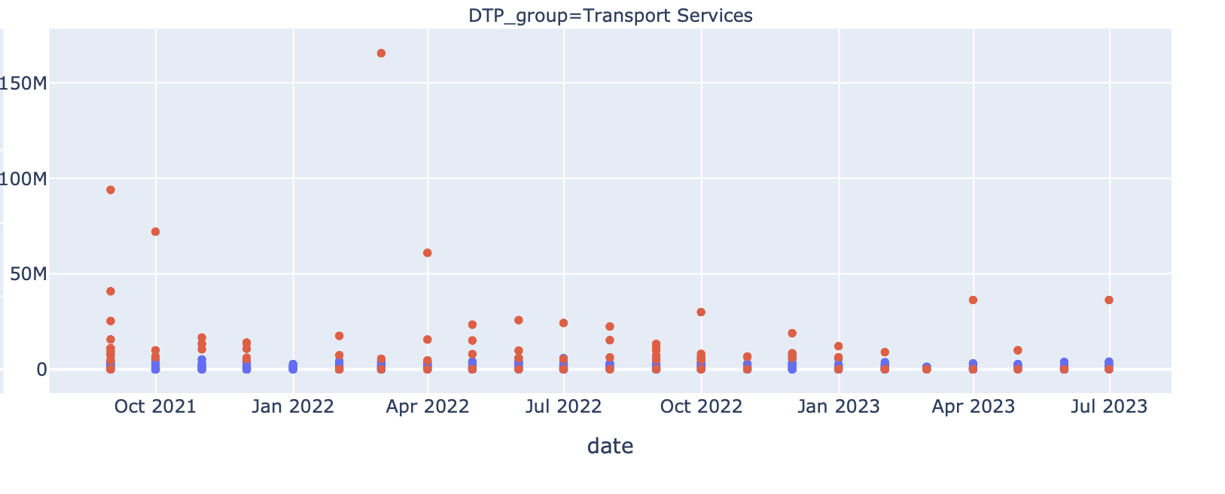
Changing contamination factor
Contamination = 0.025
Contamination = 0.05

Slide 16
How to combine models?
Combine models using OR logic?
Final dataset had anomalies from both models.
Number of anomalies shot up.
Most of the anomalies were not desired.
Combine models using AND logic?
Final dataset had anomalies common in both models.
Got the best out of both the models.

Slide 17
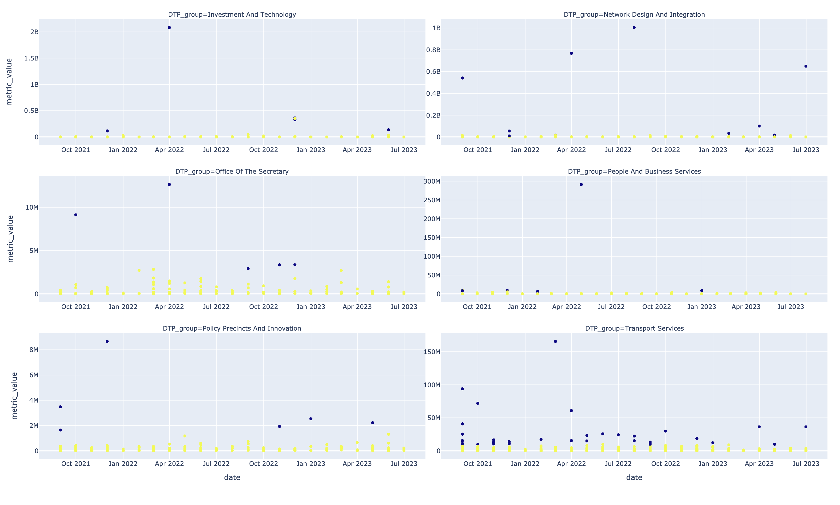
Combining models

Slide 18

Questions?

